Slide 1
Predicting Youth Substance Use with Decision Trees and Ensemble Models
Binary & Multi-Class Classification + Regression on National Survey Data
Your Name: Fariha Shah Course/Instructor: Dr. Mendible Date: 4/15/2025

Slide 2
Introduction
Objective:
Investigate predictors of marijuana and alcohol use among youth.
Focus on binary, multi-class, and regression problems using survey data.
Dataset:
National Survey on Drug Use and Health (NSDUH).
Variables include demographics, peer influence, parental opinion, risk perception, and behavioral history.
Questions Investigated:
Can we predict marijuana use based on peer/parental influence?
Can we classify frequency of use?
Can we predict age of first alcohol use?
Models Used:
Decision Trees, Random Forest, Gradient Boosting (Classification & Regression)

Slide 3
Theoretical Background
Decision Tree
Hierarchical model that splits data based on feature thresholds.
Hyperparameters: max_depth, min_samples_leaf, max_leaf_nodes.
Pros: Interpretable, fast. Cons: Prone to overfitting.
Random Forest
Ensemble of decision trees (bagging).
Reduces variance, improves accuracy.
Hyperparameters: n_estimators, max_depth.
Feature importance helps interpretation.

Slide 4
Theoretical Background
Gradient Boosting
Sequential ensemble model improving residuals.
Lower bias than RF, often better for imbalanced data.
Hyperparameters: learning_rate, n_estimators, max_depth.
Model Evaluation Metrics:
Classification: Accuracy, Precision, Recall, F1-Score, Confusion Matrix.
Regression: Mean Squared Error (MSE).
Used GridSearchCV for hyperparameter tuning.

Slide 5
Methodology
Data Processing:
Categorical encoding using pd.factorize().
Filtering youth-related features.
Removed missing values (dropna()).
Correlation between predictors and youth features.
Grouped multi-class labels for marijuana use.
Model Development:
Split data: 70% train, 30% test.
Applied cross-validation (5-fold, 10-fold).
Tuned trees with GridSearchCV.

Slide 6
Methodology
Tasks:
Binary Classification → MRJFLAG
Multi-class Classification → MRJYDAYS grouped
Regression → IRALCAGE

Slide 7
Result
Binary Classification (MRJFLAG)
Best Model: Random Forest
Model | Accuracy | Precision (Class=1) | Recall (Class=1) | F1-Score
Decision Tree | 74.6% | 37% | 78% | 50%
Pruned Tree | 78.0% | 40% | 74% | 52%
Random Forest | 84.0% | 51% | 44% | 47%
Gradient Boosting | 84.1% | 51% | 43% | 47%

Slide 8
Result
Interpretation
Decision Trees captured more users (high recall), but had lower precision.
Ensemble methods (RF, GB) improved balance across metrics.
Overall, Random Forest is the most reliable model

Slide 9
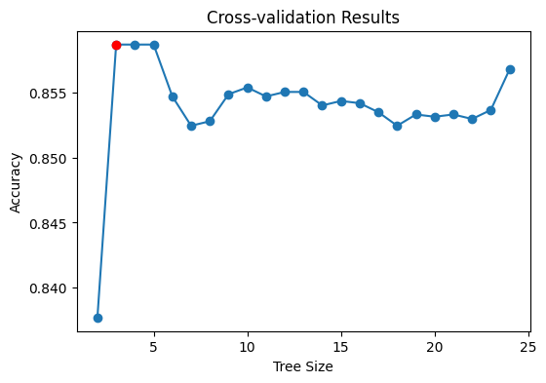
Results

Slide 10
Results
Multi-Class Classification (MRJYDAYS)
Target Classes: Light (0), Moderate (1), Heavy (2)
Model | Accuracy | Macro F1 | Key Issue
Decision Tree | 64.2% | 0.41 | Poor for Light/Moderate
Pruned Tree | 60.0% | 0.23 | Skews toward heavy users
Random Forest | 64.5% | 0.39 | Decent recall for class 1
Gradient Boosting | 87.6%* | 0.31 | Only predicts heavy users

Slide 11
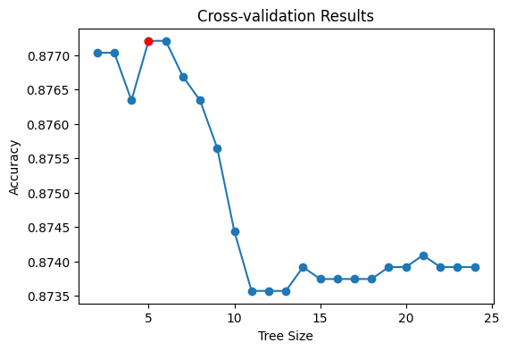
Results

Slide 12
Results
Interpretation
GB appears best in accuracy, but only predicts one class.
Random Forest best balances recall across all classes.
Severe class imbalance challenges classification quality.

Slide 13
Results
Regression (IRALCAGE)
Goal: Predict age of first alcohol use Best Model: Random Forest Regressor
Model | MSE | Top Features
Decision Tree | 3.72 | TALKPROB, YOGRPFT2
Pruned Tree | 3.85 | YOATTAK2, YOSTOLE2
Random Forest | 3.72 | TALKPROB, YOATTAK2
Gradient Boosting | 3.75 | TALKPROB, YOSTOLE2

Slide 14
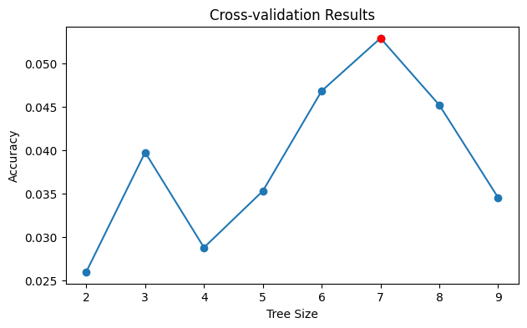
Results

Slide 15
Results
All models show similar predictive ability (~3.7 MSE).

Slide 16
Discussion
Binary Classification Takeaways
RF and GB models perform well overall.
Decision Trees have high recall (good for intervention).
Multi-Class Challenges
Heavy class dominates; Light and Moderate classes are underlearned.
Ensemble models helped, but imbalance persists.

Slide 17
Discussion
Regression
Tree-based models captured moderate signal.
Top features align with risky behavioral patterns.
Limitations
Class imbalance skews predictions.
Risk of overfitting without proper pruning.
Potential bias in survey self-reporting.

Slide 18
Discussion
Improvements
SMOTE or weighted loss for imbalance.
Try other ensembling: XGBoost, CatBoost.
Expand features (e.g., demographics, mental health).

Slide 19
Conclusion
Peer and parental influence strongly affect youth marijuana use.
Class imbalance remains a critical issue in youth behavior modeling.
Tree-based models offer interpretability and stable performance.
Findings can guide public health policies and youth intervention programs.

